Slide 1
Premier League – 2025/2026 Season
Defensive Midfielder Offensive Activity Analyses
----
Throughout the first 5 PL games

Slide 2
Table of contents
Inclusion criteria
Keep possession and move forward with the ball :
Passes Analysis
Carries Analysis
Unbalance the opponent and finish with a scoring opportunity :
Goals’ contributions
xG et xA
Chances created and Touch in the box
Principal Component Analysis (PCA) and Players’ Clustering
Conclusion
Cautions and perspectives

Slide 3
1st part – Inclusion criteria
For the analysis, as I wanted to select and analyze the same profile of players, I needed to make a selection based on several criteria :
Players’ most common position ➔ Defensive Midfielder or Centre Midfielder
Team’s most common formation ➔ Backline of 4
Minimum of minutes played ➔ < 360min out of 450 minutes since the start of the season (5 games)
The objective is to analyze the offensive activity of starters who have a pivot role in a deep position.

Slide 4
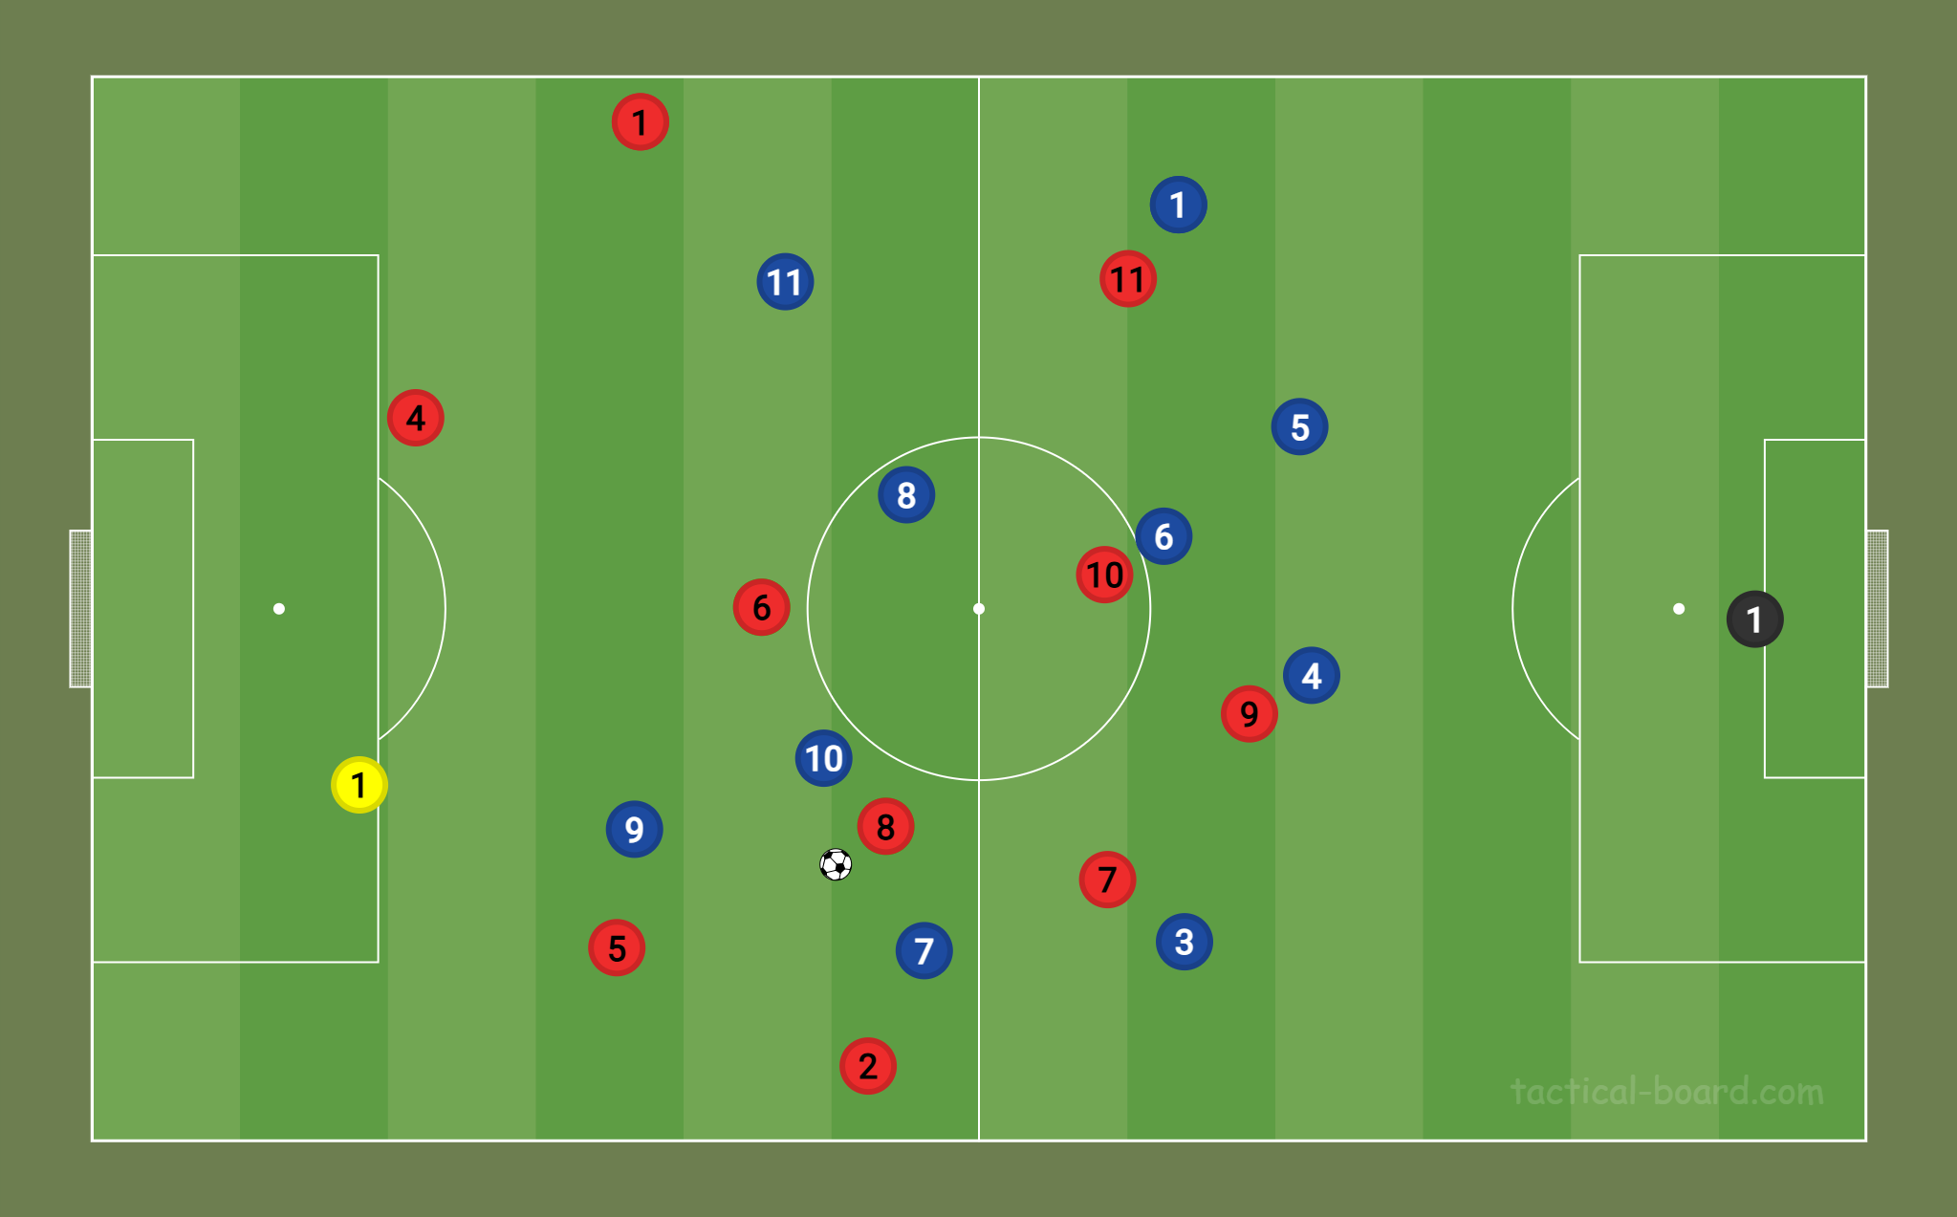
2nd part - Keep possession and move forward with the ball
3
3
Play areas of interest
Players of interest

Slide 5
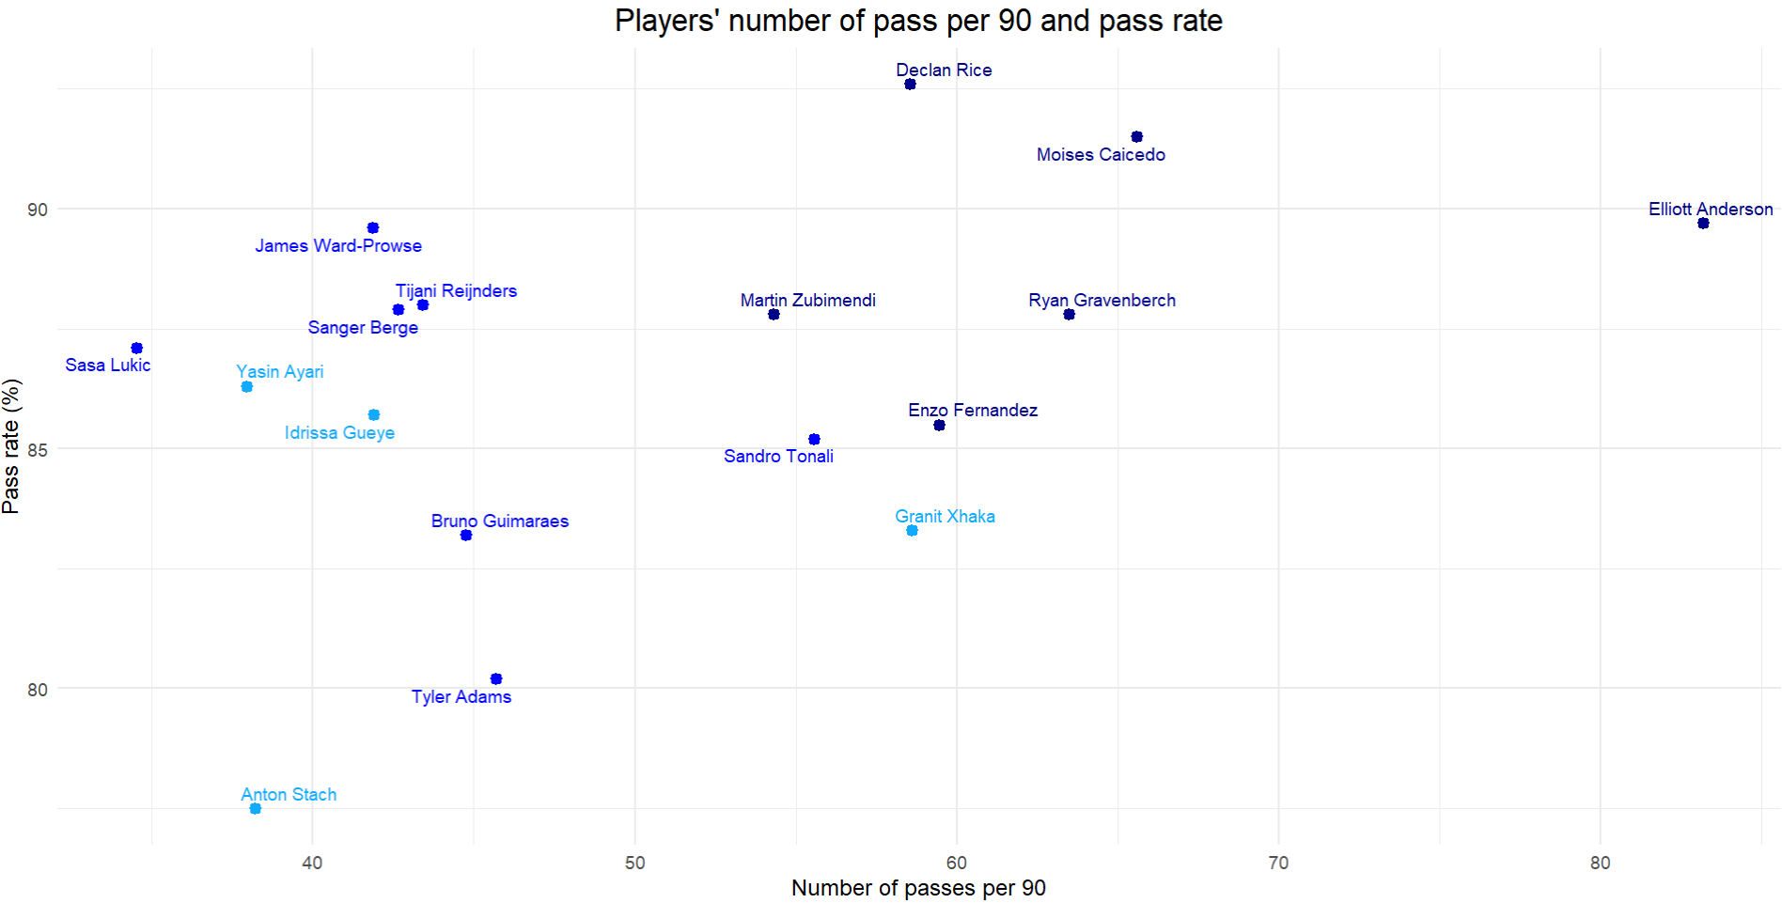
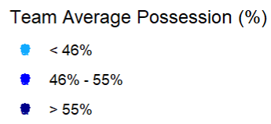
1- Passes Activity

Slide 6
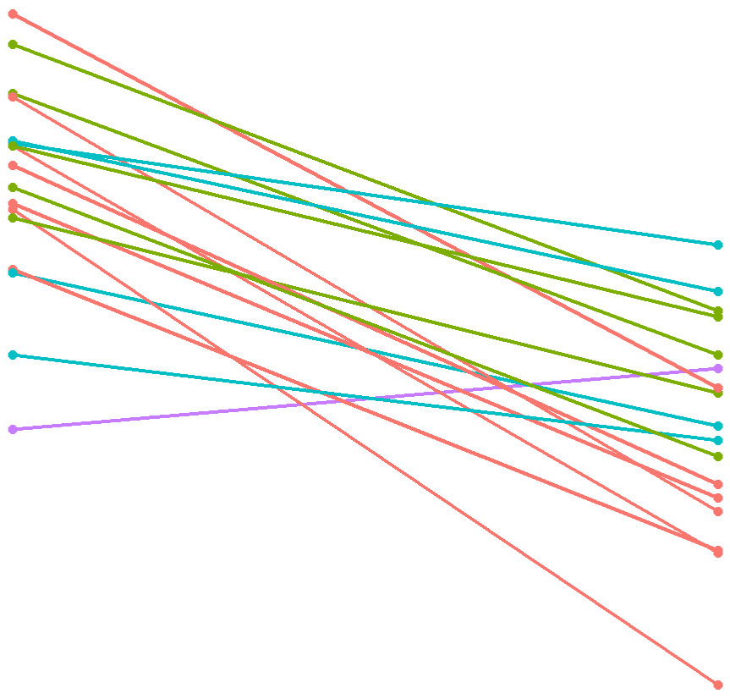
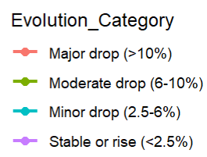
Pass completion Rate Evolution
Interactive figure link
S.Berge
Pass Rate Evolution Category
T.Reijnders
M.Caicedo – R.Gravenberch
E.Anderson
A.Stach
D.Rice - S.Tonali
T.Adams – B.Guimaraes
Y.Ayari
S.Lukic – I.Gueye – J.Ward-Prowse
G.Xhaka
M.Zubimendi
E.Fernandez
Total Passes
Final 3rd Passes

Slide 7
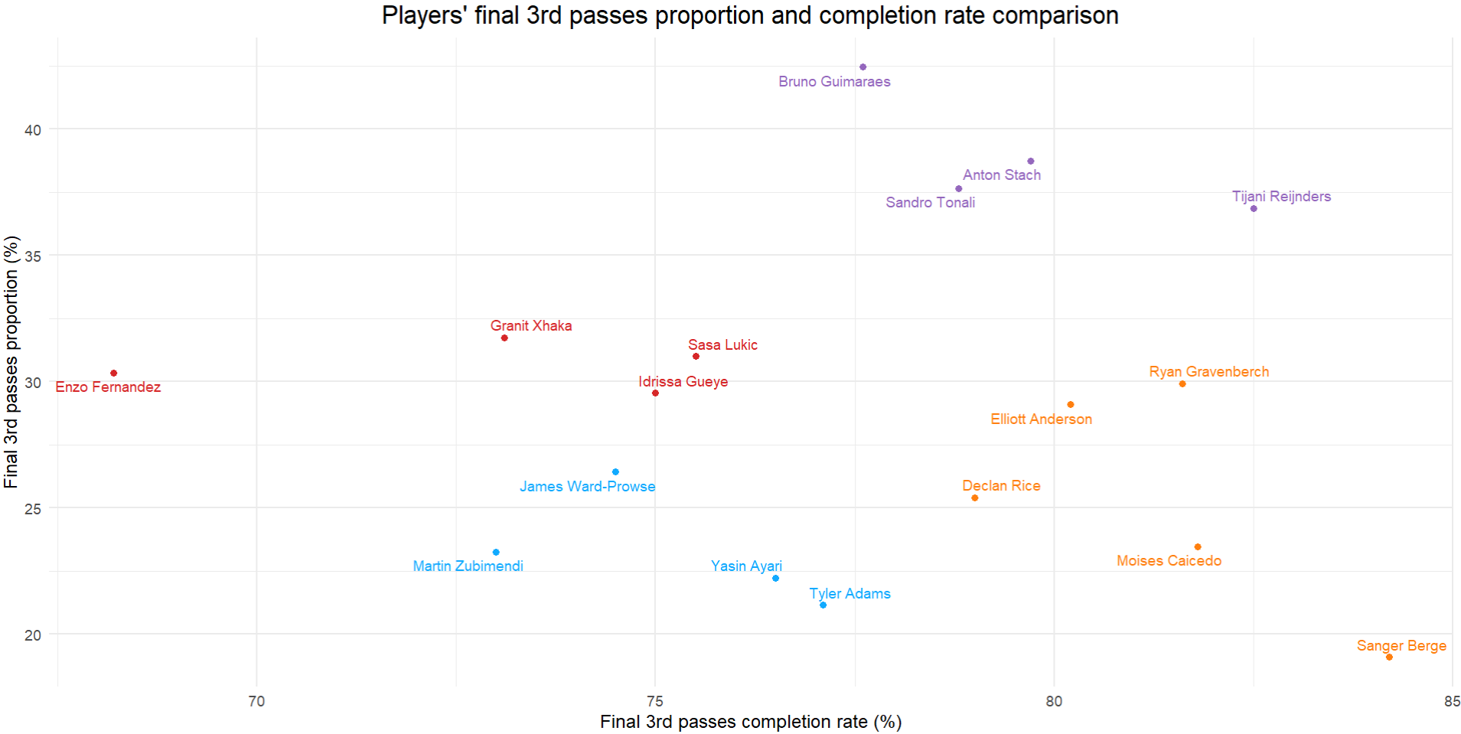
Final 3rd experts
Inaccurate
Final 3rd players
Accurate
Final 3rd players
Non Final 3rd players

Slide 8
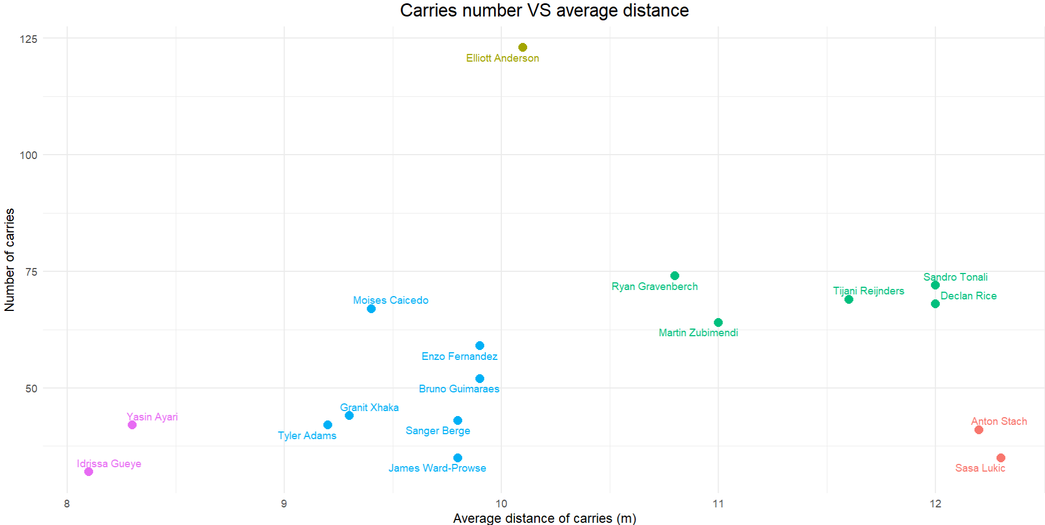
2- Carries Activity
Huge number/medium distance
Medium number
/long distance
Small number
/medium distance
Small number
/long distance
Small number
and distance

Slide 9
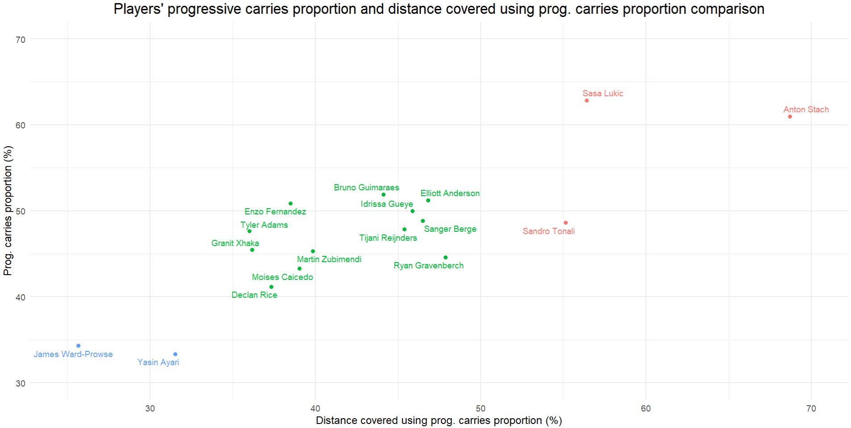
Low-to-intermediate progressive players
Progressive plays specialists
Non-progressive players

Slide 10
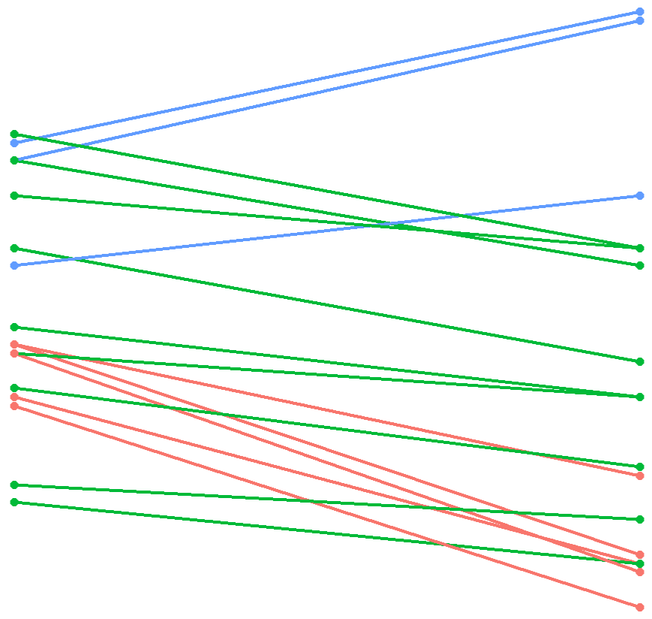
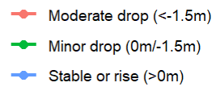
Average carries distance Evolution
Interactive figure link
A.Stach
S.Tonali
R.Gravenberch
Average carries distance evolution Category
S.Lukic – T.Reijnders
D.Rice
M.Zubimendi
E.Anderson – S.Berge
M.Caicedo
B.Guimaraes
Y.Ayari
E.Fernandez
G.Xhaka - I.Gueye
J.Ward-Prowse
T.Adams
Total carries
Progressive carries

Slide 11
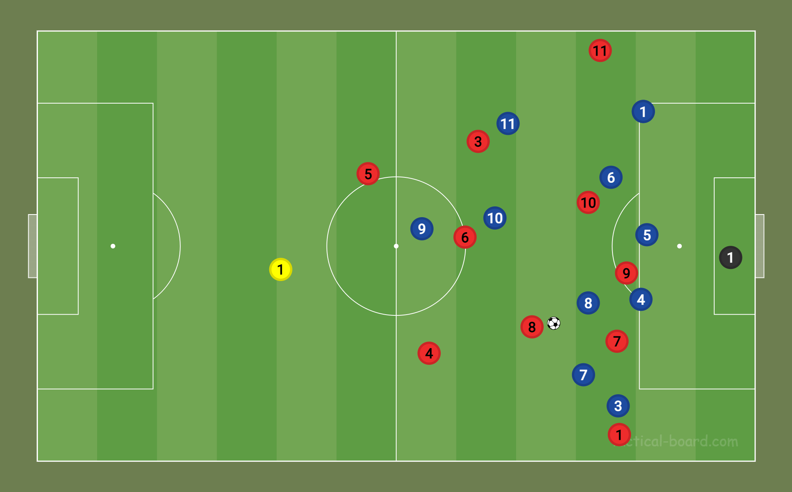
3rd Part - Unbalance the opponent and finish with a scoring opportunity
3
Play areas of interest
Players of interest
2

Slide 12
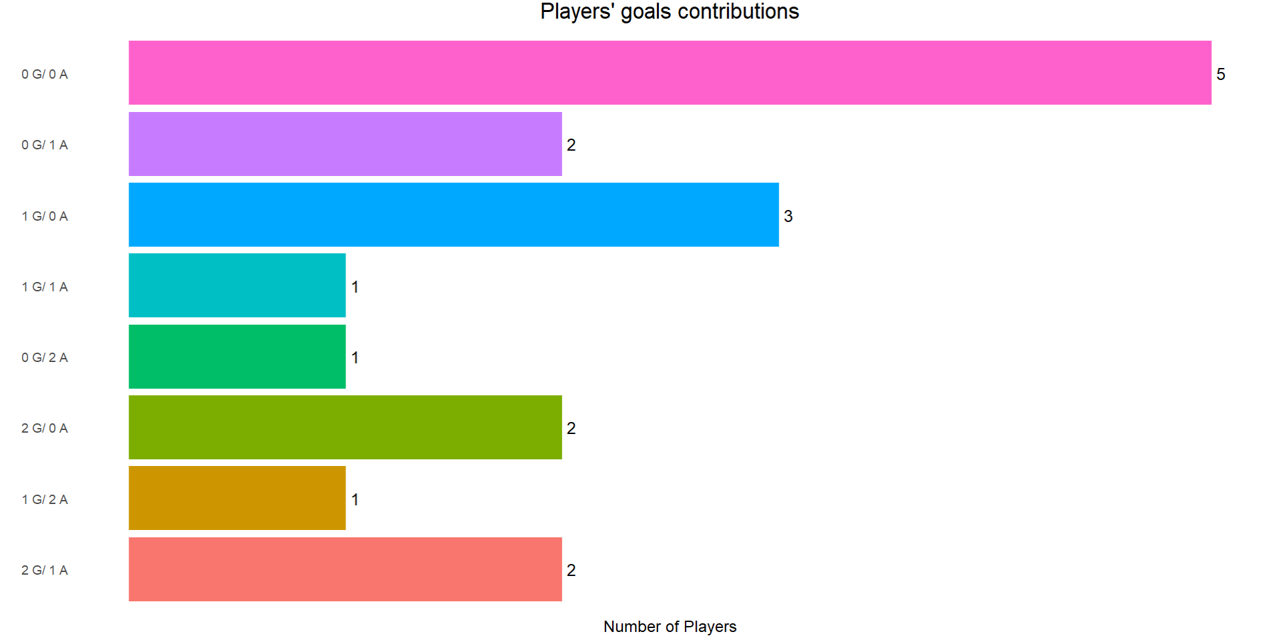
1- Goals’ contributions
T.Adams – S.Lukic – S.Tonali – S.Berge – J.Ward-Prowse
E.Anderson – D.Rice
I.Gueye – Y.Ayari – B.Guimaraes
A.Stach
G.Xhaka
M.Zubimendi
T.Reijnders
E.Fernandez – R.Gravenberch

Slide 13
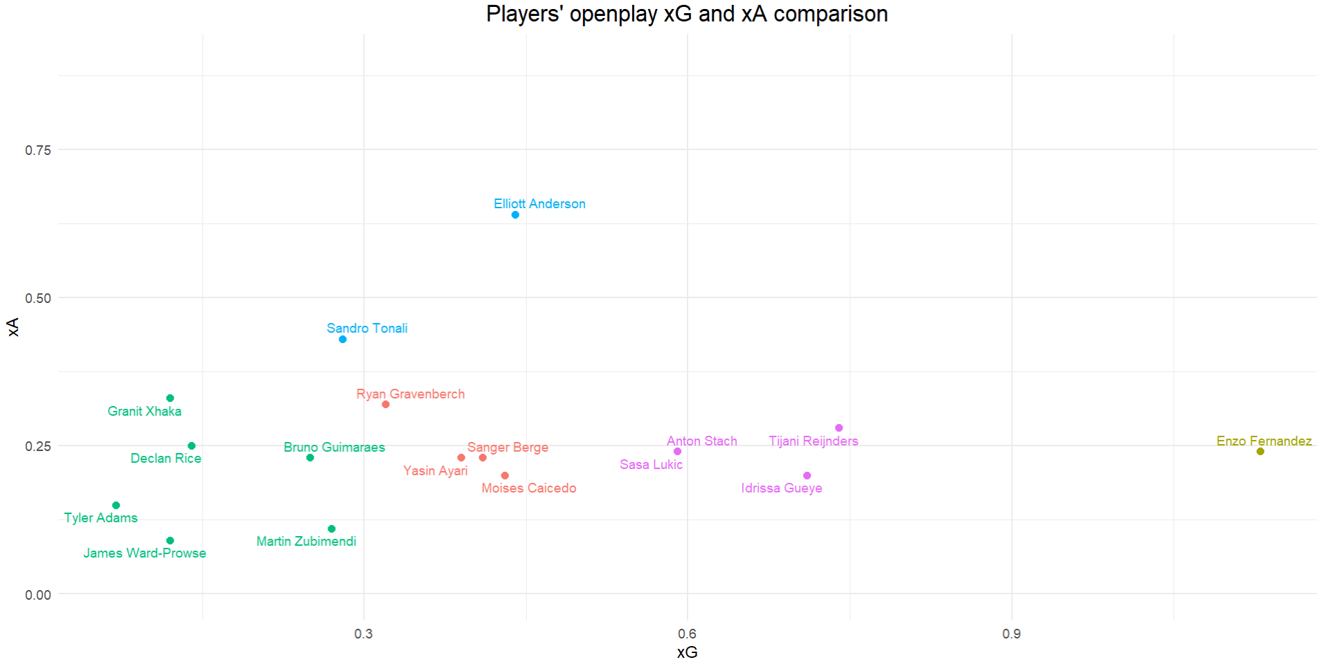
2- Openplay xG and xA
Creators
OP xAssists
Offensive threats
Neutral
Goal-oriented
Not offensively impactful
OP xG

Slide 14
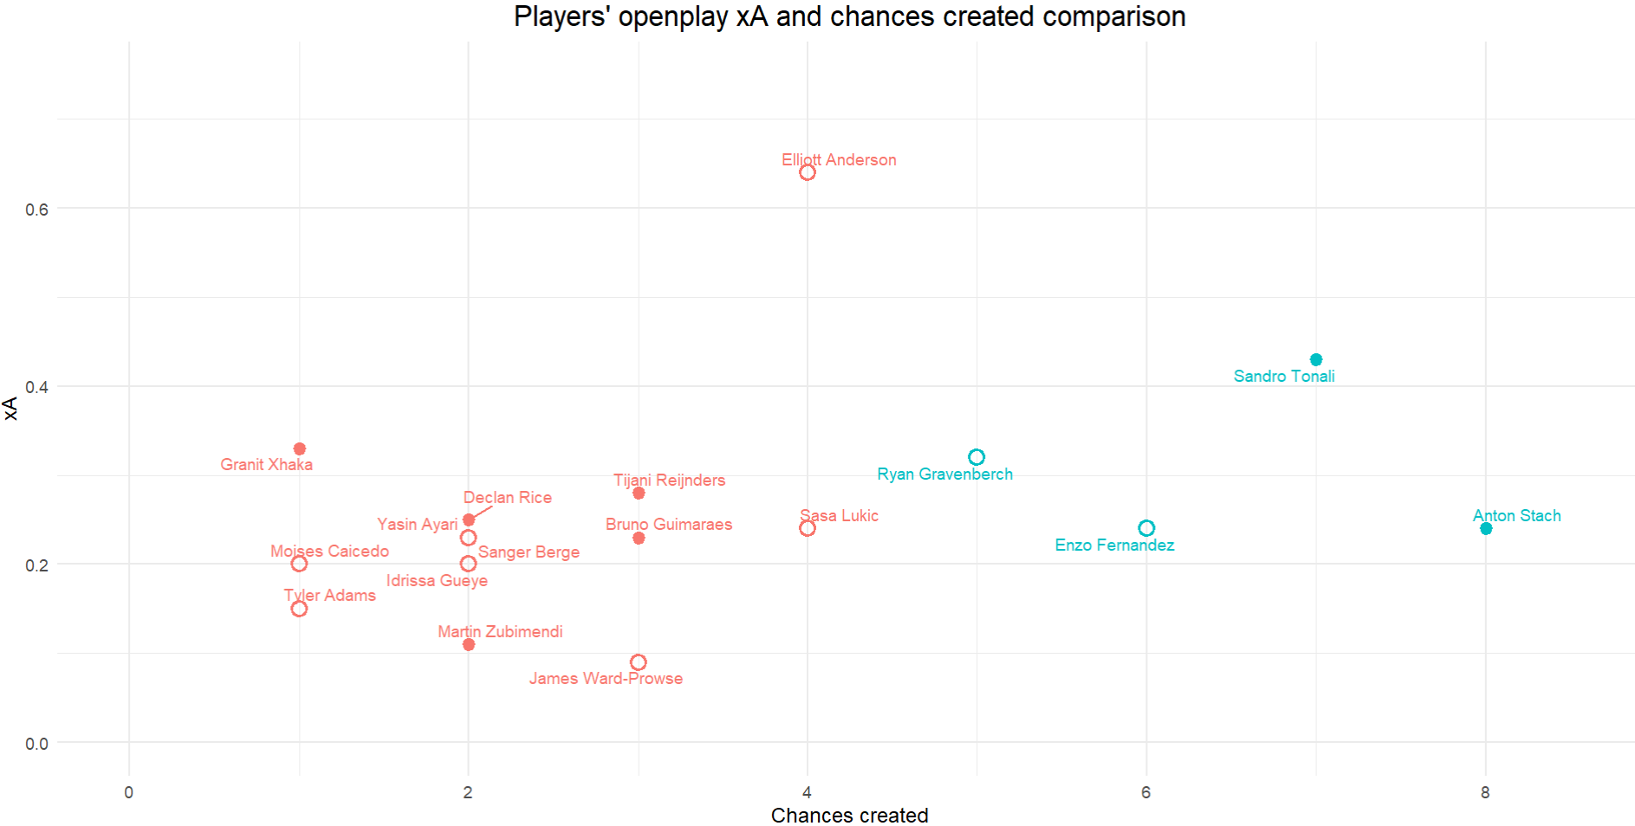

3- Chances created and touches in opp. box
xAssists

Slide 15
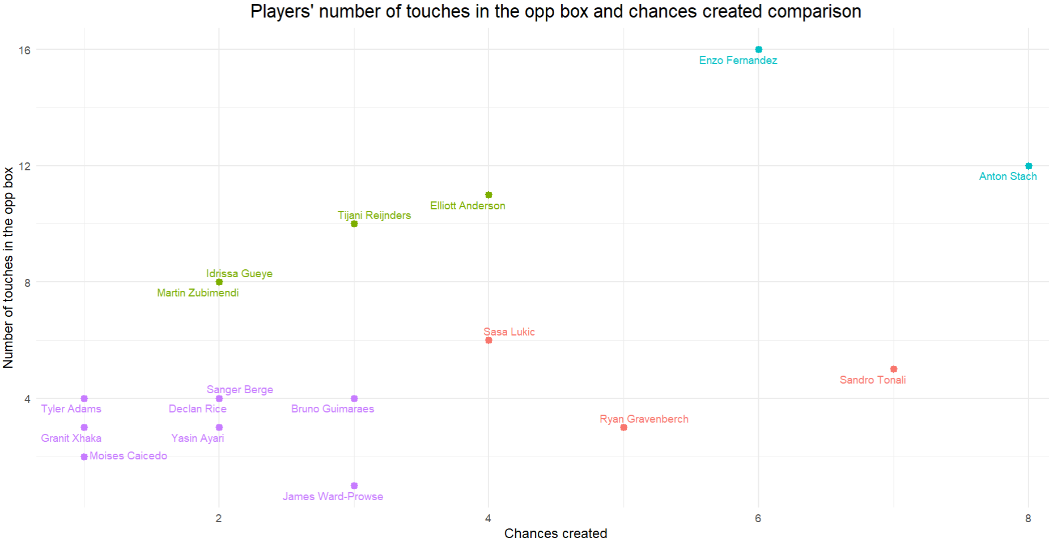
Inside-the-box threats
Inside-the-box options
Outside-the-box threats
Offensive builders

Slide 16
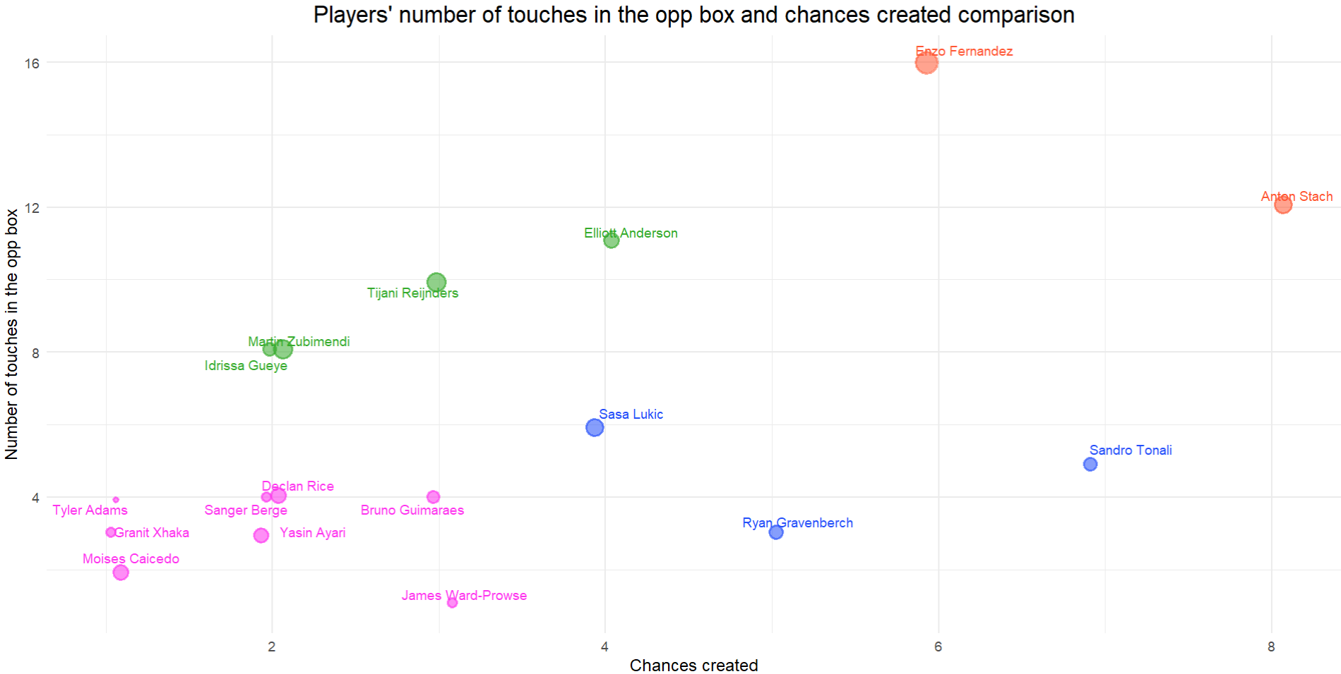
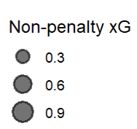
Inside-the-box threats
Inside-the-box options
Offensive builders
Outside-the-box threats

Slide 17
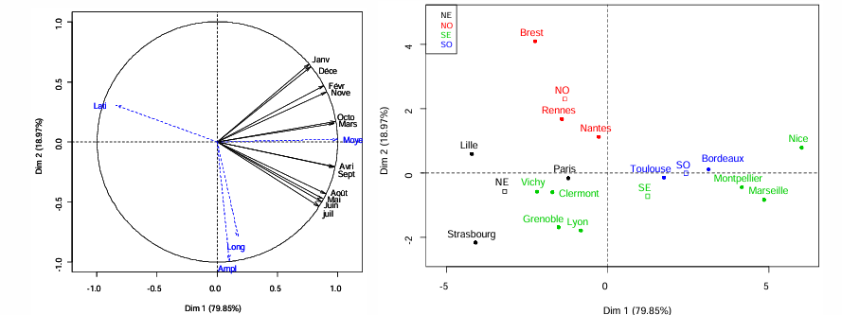
4th part - Principal Component Analysis (PCA) and Hierarchical Classification on principal components (HCPC)
Analyse en composantes principales (ACP)

Slide 18
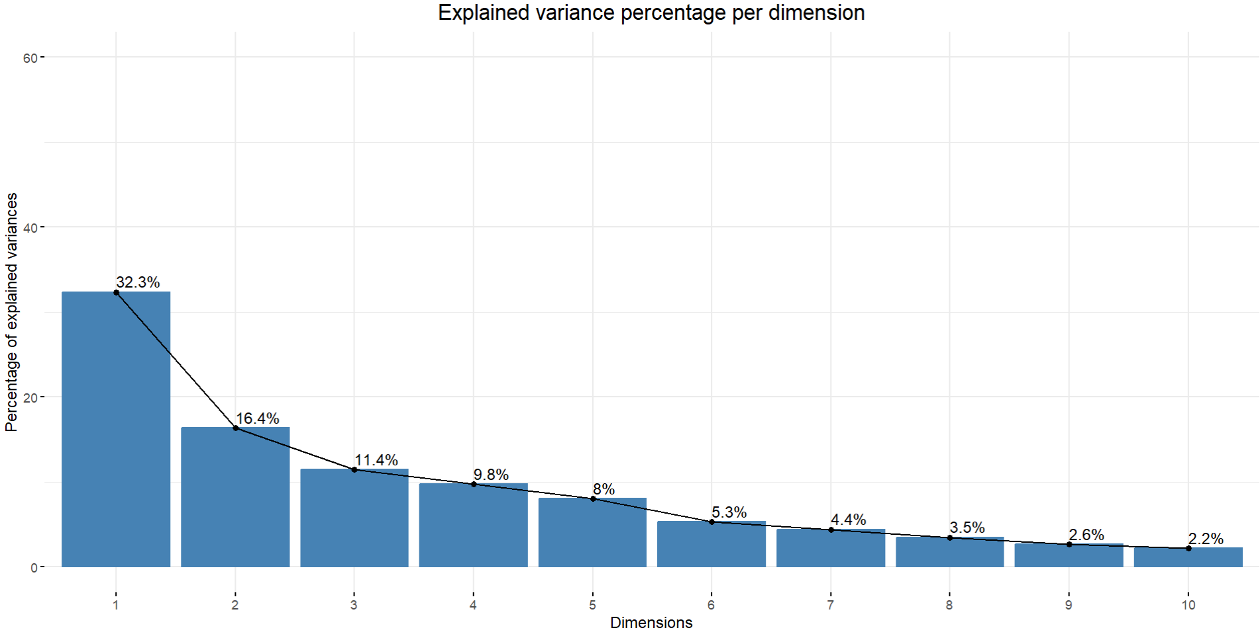

Slide 19
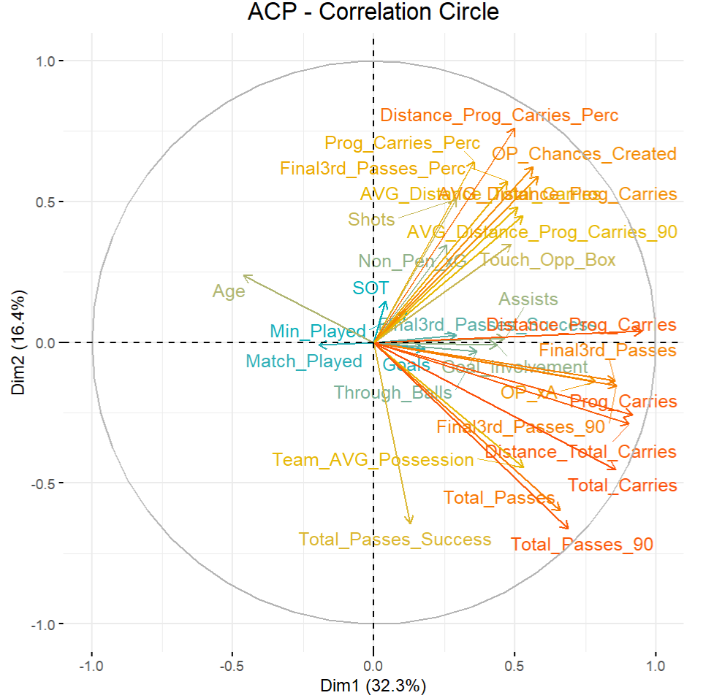
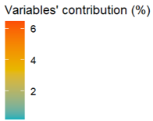

Slide 20
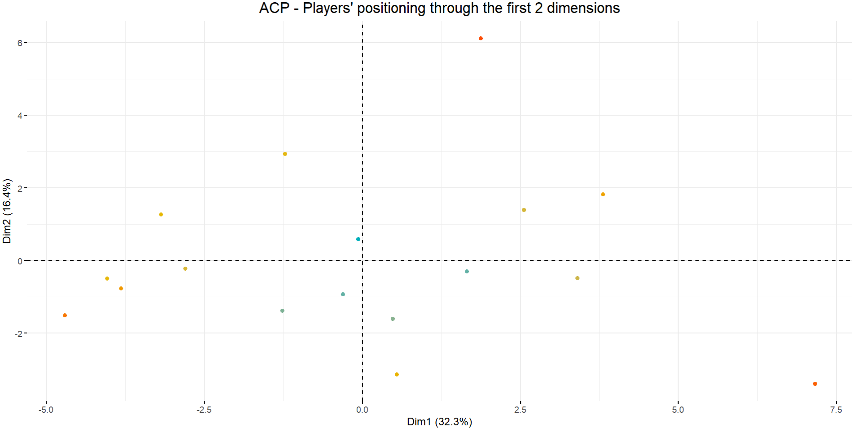
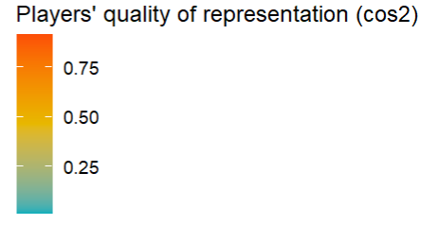
5 players who aren’t well represented on those 2 dimensions

Slide 21
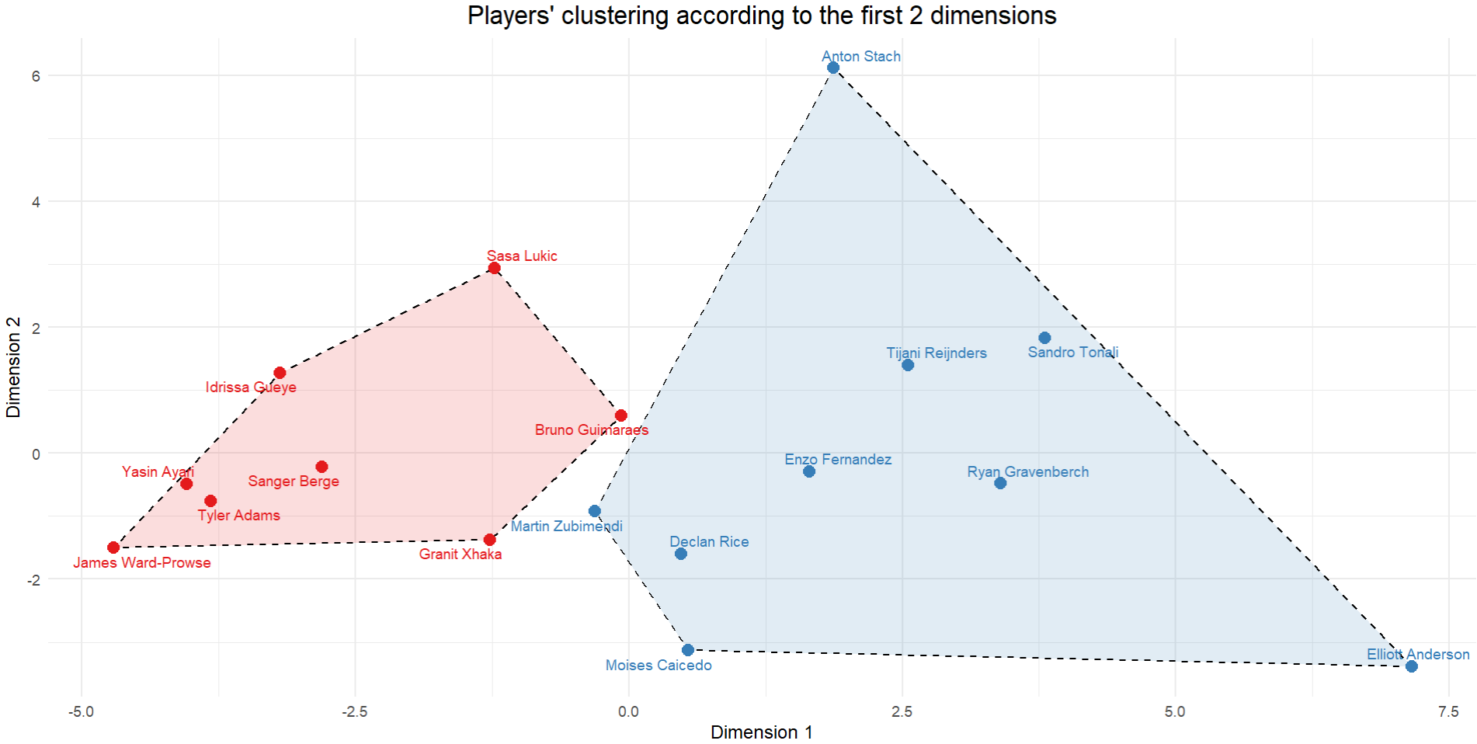
Cluster 2
Cluster 1

Slide 22
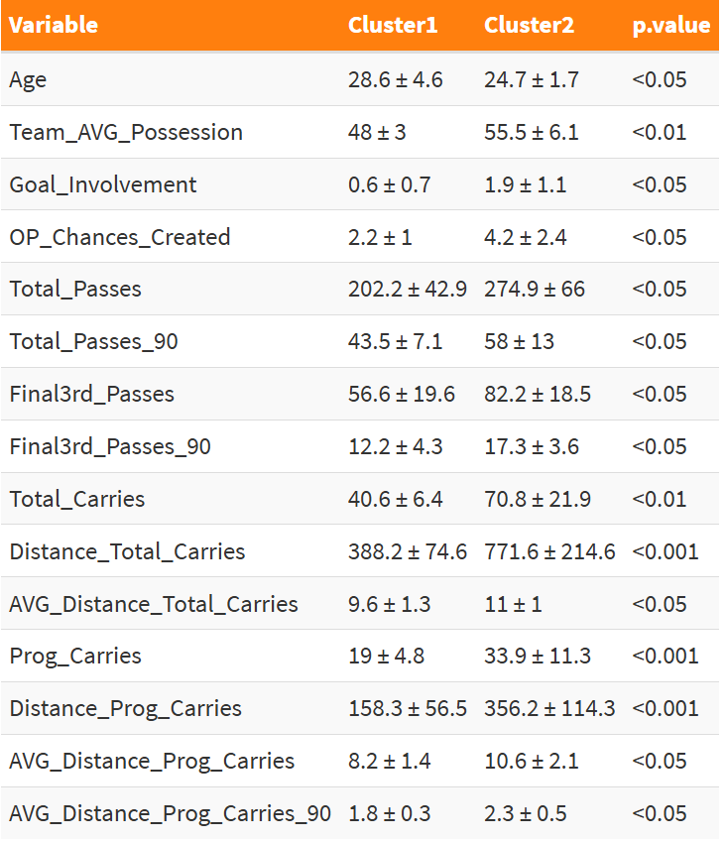
Statistical comparison of variables between the two clusters
Interactive table link

Slide 23
5th Part - Conclusion
By combining players’ clustering and comparing the variables of both clusters, we can observe and admit that, over the first five games of the season, two profiles of central midfielders stand out :
Cluster 1 : Holding midfielders
who are far from the danger zone
(goal contributions, chances created, final 3rd passes)
in a non-dominant squad (team possession)
so less passes and carries
(passes and carries metrics)
Cluster 2 : Offensive playmakers
who contribute to chances and goals,
(goal contributions, chances created, final 3rd passes)
dictate the team ball’s activity,
(number of passes, number and distance of carries)
-and progressive plays in the opponent’s half (final 3rd passes, number and distance of progressive carries)

Slide 24
Last Part – Cautions and Perspectives
We cannot draw any conclusions from this work, since we only worked on the first five games of the season, and the dimensions chosen for the PCA do not define the group of players precisely enough.
To go further :
Automate data extraction (web scraping or API)
Continue the analysis over the entire season (will include many more players)
Include GPS data in order to process with runs’ directions with/without the ball, or % of runs at x km/h…

